Slide 1



M/s. Mother India Life Spaces and Infra Engineering Limited, INDIA.
(Deals in Exports: All Agricultural Food Products, FMCG., Construction Materials, Garments,
Jute, Coco Pet, Chemicals, Abrasives)
The Reverse Buyer – Seller Meet (RBSM)
M/s. Nivi Exim Pty.Limited, Australia
On dated: 18.02.2025 & 19.02.2025
At: Venue: Hotel Radisson Blu Resorts, Visakhapatnam.

Slide 2
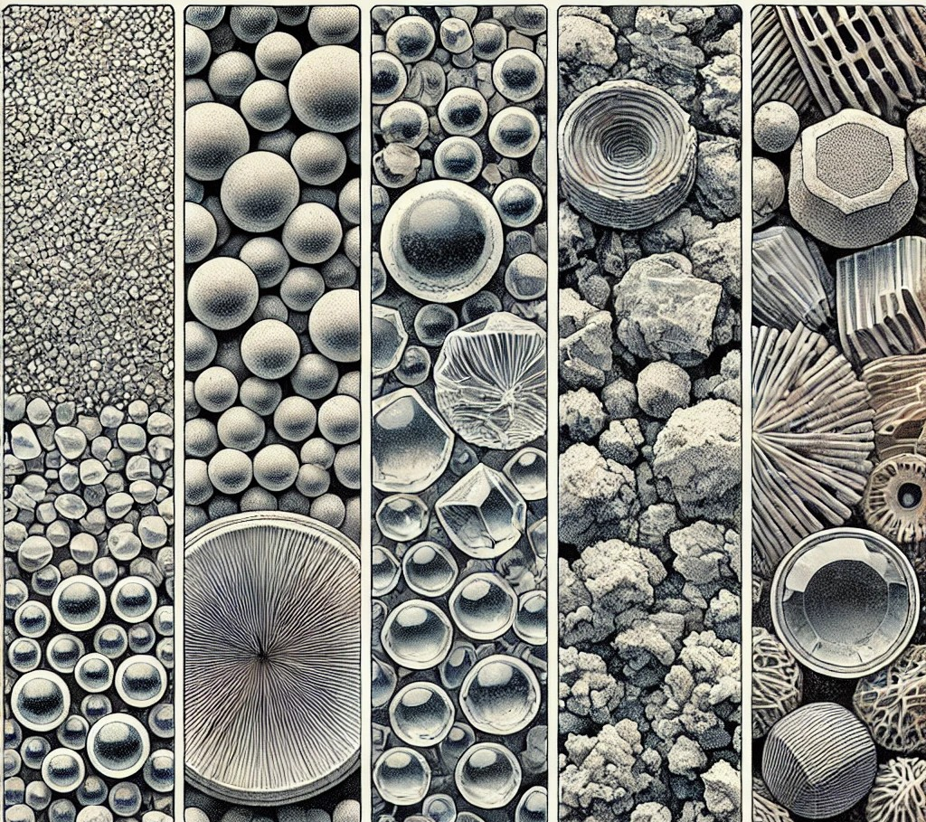
Abrasives Media
Brown Fused Alumina
Indian Garnet
Glass Beads
Steel Shot
Steel Grits
White Fused Alumina
Pink Fused Alumina
Black Silicon Carbide
Copper Slag
Quartz Sand

Slide 3
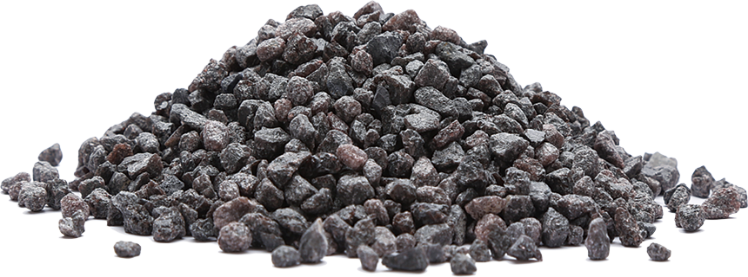

1.Brown Fused Alumina
Description
Brown Fused Alumina (BFA) is a tough, durable synthetic abrasive made from bauxite. blocky shape and high density
DOMILL provides abrasive grains with varying bulk density, particle size, chemical composition to meet the needs of industries such as grinding wheels,
sandpaper manufacturing, sandblasting, and refractory materials.
USAGE:
Cleaning steel constructions,
Cleaning and decorating non-ferrous materials – glass, stone, bricks etc.,
Cleaning mould casts and metal moulds,
Filling material.
Grinding Wheels grinding wheels are one of the most common applications of brown fused alumina.
Polishing and Surface Finishing In addition to grinding
Refractories.
Available Sizes : 12, 14, 16, 20, 22, 24, 30, 36, 40, 46, 54, 60, 70, 80, 90, 100, 120, 150, 180, 220, 240

Slide 4
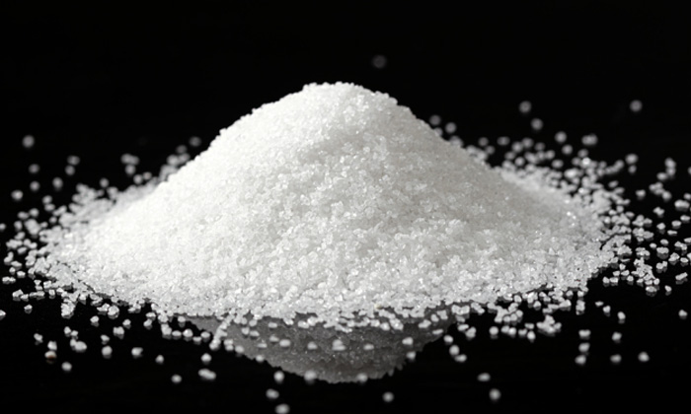
2. White Fused Alumina
White Fused Alumina (WFA) is a high-purity form of aluminum oxide (Al₂O₃) produced by fusing calcined alumina in an electric arc furnace at extremely high temperatures. This material is well-known for its hardness, durability, and exceptional thermal properties, making it ideal for various industrial applications, such as abrasives, refractories, and ceramics.
Usages:
Grinding & Cutting Tools
Surface Preparation
Polishing & Finishing
Refractory Materials
Refractories
Body and Vehicle Armor Blasting
Polishing
Lapping
Anti-Slip
Laminates Coatings and Filtration
Available Sizes

Slide 5
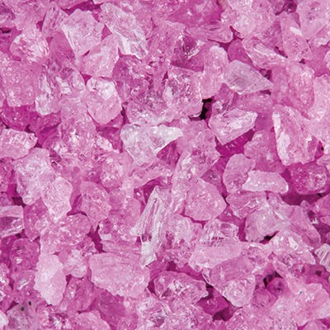
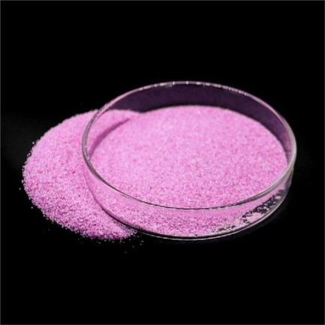
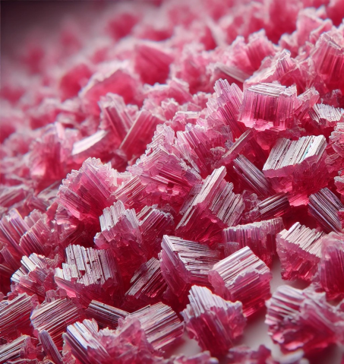
3.Pink Fused Alumina (PFA)
Pink Fused Alumina (PFA) is a high-performance abrasive made from aluminum oxide with added chromium oxide, which gives it a distinct pink color. The chromium content enhances toughness and durability, making PFA ideal for demanding grinding and cutting tasks.
Used for precision grinding of measuring tools
lathe main shafts
instruments and apparatus parts
threading work pieces and
many other applications in grinding like flute grinding, tooth grinding, dry grinding of blade segments, tool and internal grinding and mounted point.
The best suitable for high alloy steel applications, ideal for tool sharpening such as high speed steel cutters, reamers, chisels, end mill and sharpening band saw blades.
Available Sizes - FEPA Standard - F24, F30, F36, F40, F46, F54, F60, F80, F100, F120
JIS Standard - #24, #30, #36,#40, #46, #54, #60, #80, #100, #120

Slide 6
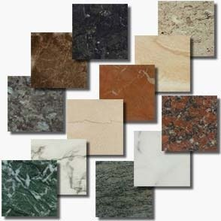
4. Indian Garnet
Indian granite is a durable, attractive, and affordable stone that comes in many colors and varieties. It's used for construction and decoration around the world.
Uses of Granite:
Construction
Countertops
Flooring & Tiles
Sculptures & Monuments
Paving & Landscaping
Types of Granite:
White Granite, Black Granite, Brown, Pink/Red Granite, Green Granite, Blue Granite.

Slide 7
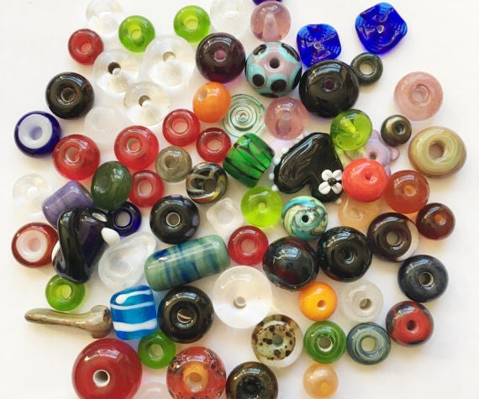
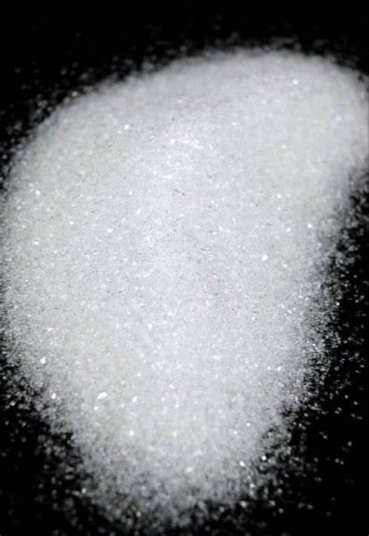
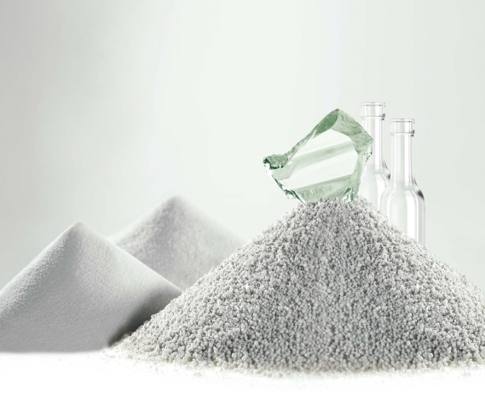
5. Glass Beads
Glass beads are commonly used as abrasives in blasting and polishing applications. They are made from high-quality soda-lime glass and are designed to be chemically inert, environmentally friendly, and reusable.
Uses of Indian Garnet:
Blasting,
cleaning and surface finishing of metallic parts,
especially more effective on stainless steel,
food processing equipment
Mold Cleaning.
Aerospace & Automotive Applications
medical instruments.
Shot peening of aircraft engine blades, turbine rotors,
gears,
shafts,
steam and gas turbine components.
Glass Beads
Crushed Glass
Glass Powder
Available Sizes
Fine Beads (100-325 mesh) – Ideal for polishing and finishing delicate surfaces.
Medium Beads (40-100 mesh) – Used for general-purpose cleaning and peening.
Coarse Beads (20-40 mesh) – Suitable for heavy-duty cleaning and surface preparation.

Slide 8
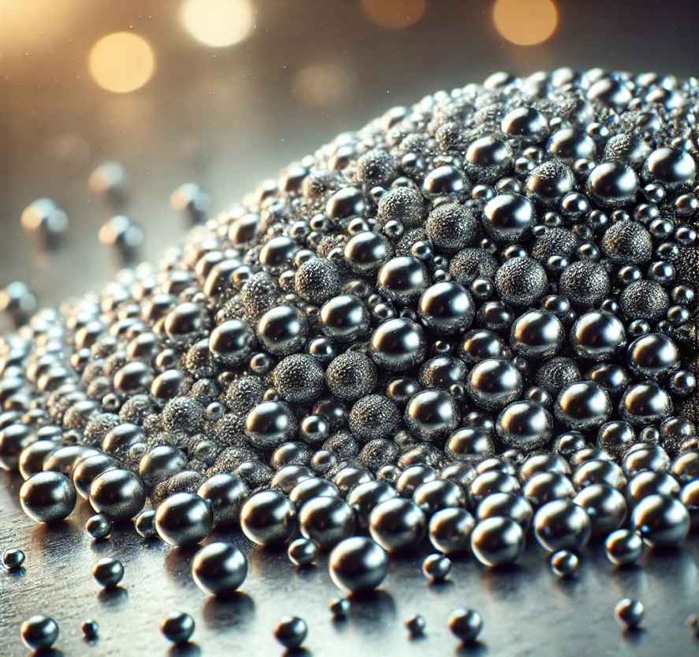
6.Steel Shot- A Powerful Metallic Abrasive
Steel shot is a spherical metallic abrasive made from carbon steel. It is widely used in surface preparation, cleaning, shot peening, and polishing applications due to its durability, recyclability, and effectiveness in strengthening metal surfaces.
Uses of Indian Garnet:
Surface Cleaning & Preparation
Shot Peening (Strengthening Metal Components)
Cleaning Foundry Castings & Forgings
Surface Finishing & Polishing
Pipeline & Tank Cleaning
Road Surface Preparation
Seed Beads (Tiny Beads) - 1.3mm, 2mm, 3mm, 4mm
Round & Faceted Beads - 2mm, 3mm, 4mm, 6mm, 8mm, 10mm, 12mm, etc.
Bugle Beads (Tube-Shaped) - Sizes range from 2mm to 35mm in length
Pony Beads - Usually 4mm-9mm in diameter with a larger hole

Slide 9
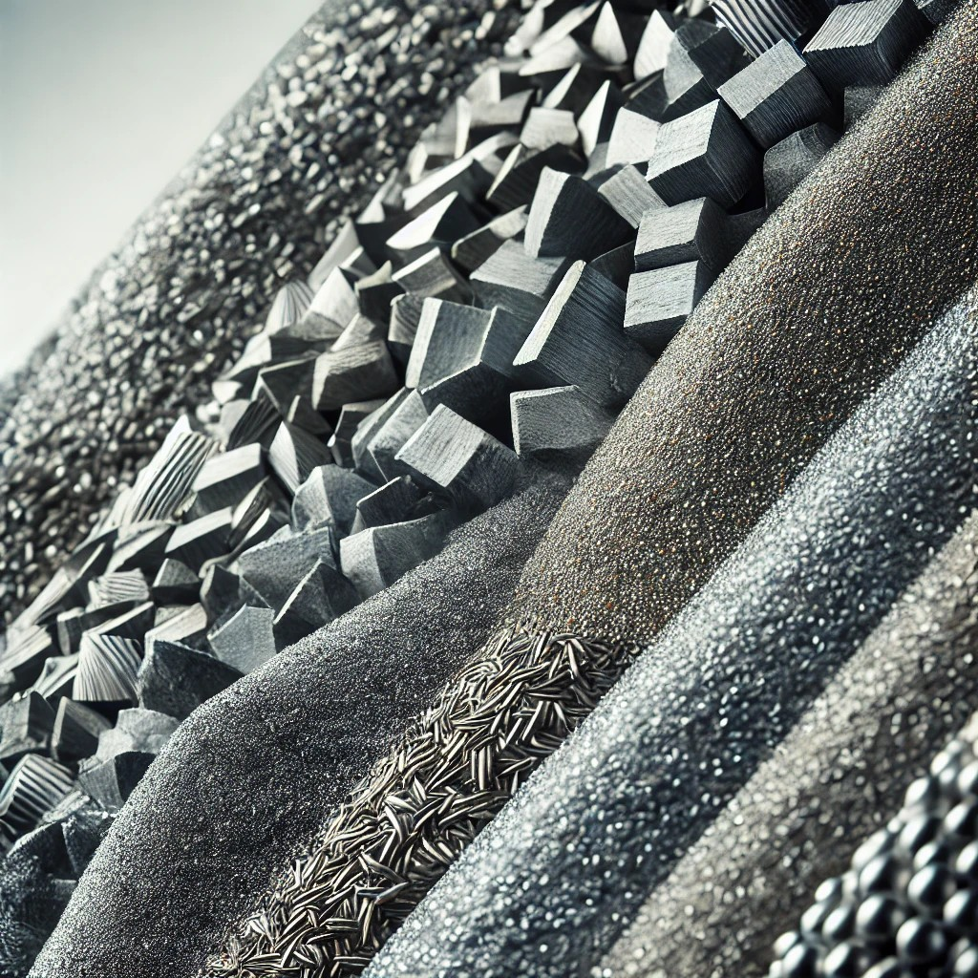
7.Steel Grits
G14 (1.40 - 2.00mm) – Heavy-duty cleaning, surface roughenin
G16 (1.20 - 1.70mm) – Rust removal, general blasting
G18 (1.00 - 1.40mm) – Paint removal, surface profiling
G25 (0.71 - 1.18mm) – Medium cleaning, coating preparation
G40 (0.42 - 0.84mm) – Light cleaning, finishing
G50 (0.30 - 0.71mm) – Fine blasting, polishing
G80 (0.18 - 0.42mm) – Precision cleaning, delicate surfaces
Steel Grit is an abrasive material made from crushed steel shot and is commonly used for surface preparation, cleaning, and cutting. It comes in different sizes and hardness levels depending on its application.

Slide 10
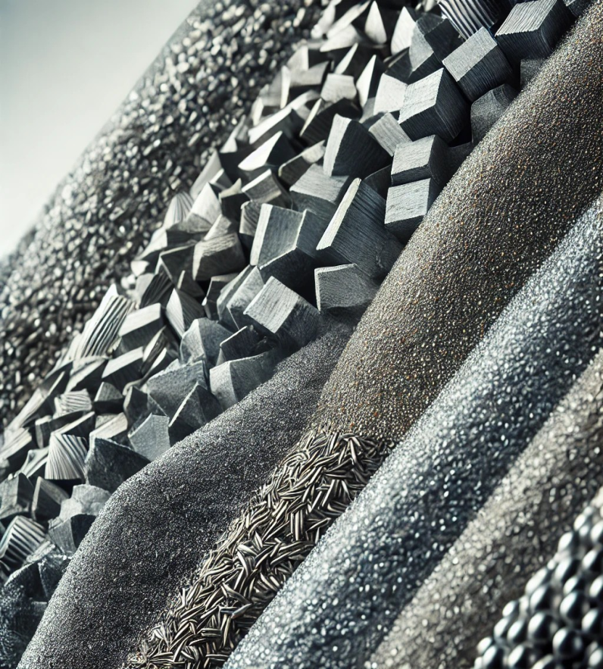
8.Black Silicon Carbide
Black Silicon Carbide (SiC) is a synthetic material made from high-purity silica sand and petroleum coke in an electric resistance furnace at high temperatures. It is known for its extreme hardness, thermal resistance, and durability.
Usages:
mounted pints
lapping and polishing media.
Grinding Wheels & Cutting wheels
Surface Blasting & Finishing
Metallurgical Applications
Refractories & High-Temperature Applications
Electronics & Semiconductor Industry
Automotive & Aerospace
oil stones and also used as blasting
Sizes: F12, F14, F16, F20, F24, F30, F36, F40, F46, F54, F60, F70, F80, F90, F100, F120, F150, F180 and F220 as per FEPA Standards.

Slide 11
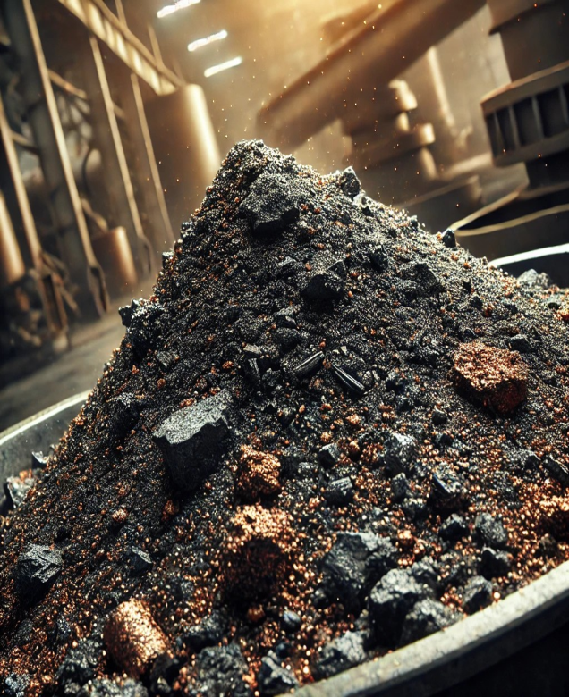
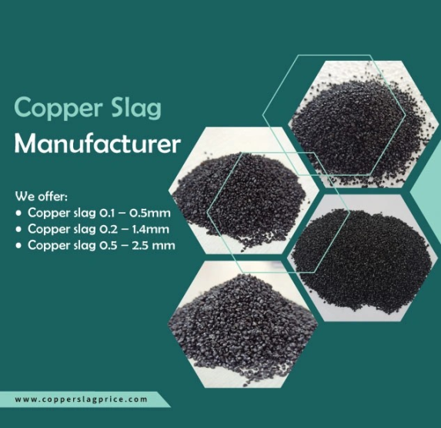
9.Copper Slag
Copper slag is a by-product of copper extraction from smelting. It consists of iron silicate and other oxides, making it a hard, dense, and abrasive material. Due to its high strength, low moisture absorption, and eco-friendly properties, it is widely used in various industrial applications.
Usage:
Abrasive Blasting
Construction Material
Shipbuilding & Offshore Industry
Roofing & Flooring:
Landfilling & Soil Stabilization:
Blast & Paint Contractor
Container Manufacturing / Repair
Marine Shipbuilding Repair
Oil and Gas/ Pipeline
Plant Maintenance
Size (Mesh) | Application
0-0.2 mm | Fine polishing & coatings
0.2-1 mm | Concrete additive, construction
1-3 mm | Shipbuilding, grit blasting
3-5 mm | Landscaping, heavy-duty cleaning
5-10 mm | Road construction, landfilling

Slide 12
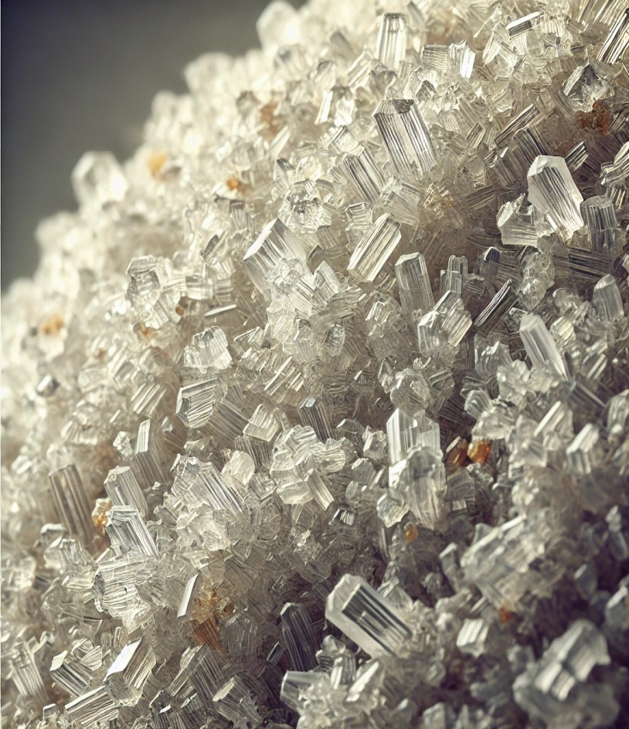
10. Quartz Sand
Quartz sand is a naturally occurring granular material composed primarily of quartz (silicon dioxide, SiO₂). It is a hard, chemically inert, and durable mineral that is widely used in various industries. The grains of quartz sand are typically white or colorless but can also appear in shades of yellow, pink, or brown due to impurities.
Usages:
Construction & Building Materials
Industrial Applications
Oil & Gas Industry
Electronics & Semiconductor Industry
Paints & Coatings
Sports & Recreation
Agriculture & Landscaping
Fine Quartz Sand (0.05 – 0.5 mm)
Medium Quartz Sand (0.5 – 1.5 mm)
Coarse Quartz Sand (1.5 – 4 mm)
Granular Quartz Sand (4 – 8 mm & above)

Slide 13
Chemicals

Slide 14
2.Food & Technical Grade Chemical
Trisodium Phosphate
Tetrasodium Pyro Phosphate
Sodium Hexameta Phosphate
Sodium Tripoly Phosphate
Sodium Carbonate
Sodium Hydrosulphite
Titanium Dioxide (Rutile Grade)
Ferric Chloride

Slide 15
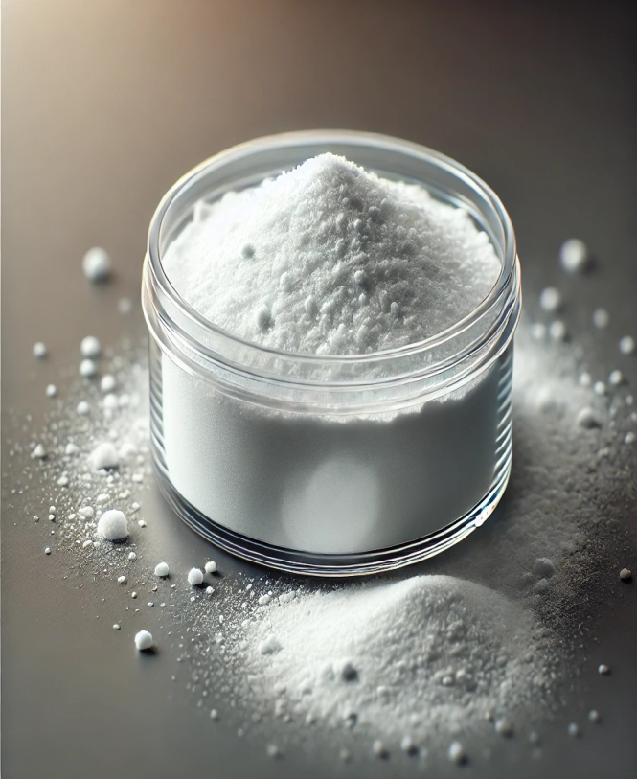
1. Trisodium Phosphate
Trisodium phosphate (TSP) is a white, crystalline or granular inorganic compound with the chemical formula Na₃PO₄. It is a highly water-soluble salt that produces a strongly alkaline solution. TSP is widely used as a cleaning agent, degreaser, and food additive due to its powerful emulsifying and buffering properties.
Uses:
Cleaning and Degreasing
Food Industry
Water Treatment
Agriculture
Construction and Painting
Detergents and Soap Industry
Pharmaceuticals and Laboratories
Fireproofing and Textile Industry
Appearance: White, granular or crystalline solid

Slide 16
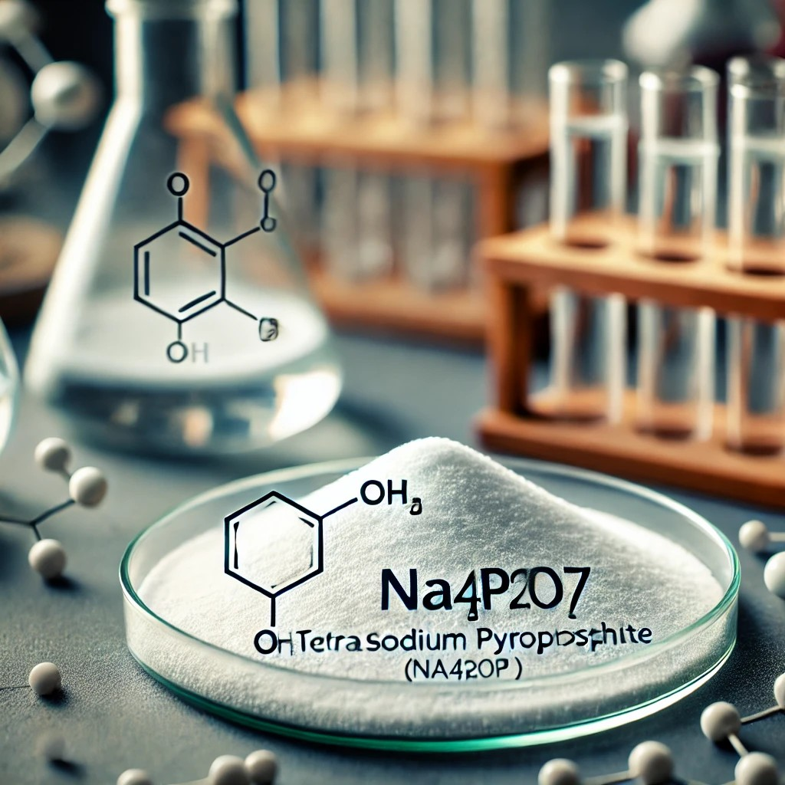
2. Tetrasodium Pyro Phosphate
Tetrasodium pyrophosphate (TSPP) is an inorganic compound with the formula Na4P2O7. It is also known as sodium pyrophosphate, tetrasodium phosphate, or TSPP. It is a white, water-soluble solid when used as a salt. It is made up of sodium ions and pyrophosphate anion. When ingested orally, the toxicity is approximately twice that of table salt. The decahydrate Na4P2O7 • 10(H2O) is also known.
Usage:
Food Industry (E450 Additive)
Detergents & Cleaning Products
Water Treatment
Personal Care Products
Metal Treatment & Industrial Applications
Physical Form: White, crystalline powder or granular solid and Texture is Fines

Slide 17
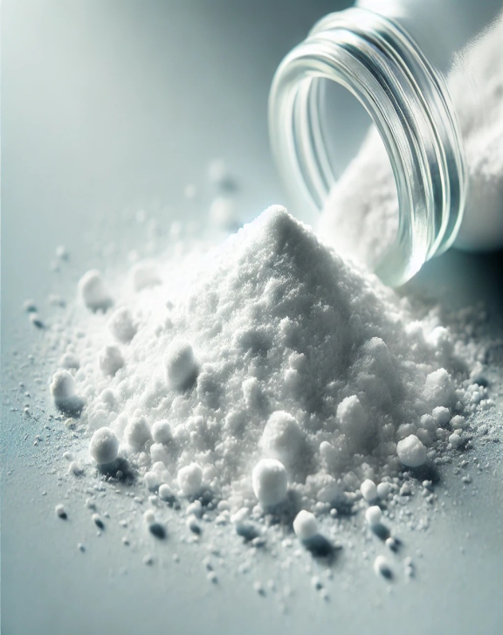
3. Sodium Hexameta Phosphate
Sodium hexametaphosphate (SHMP) is a salt of composition Na₆[(PO₃)₆].^{[3]} Sodium hexametaphosphate of commerce is typically a mixture of metaphosphates (empirical formula: NaPO₃), of which the hexamer is one, and is usually the compound referred to by this name. Such a mixture is more correctly termed sodium polymetaphosphate. They are white solids that dissolve in water.
Usage:
Food Industry
Water Treatment
Detergents & Cleaning Products
Ceramics & Paints
Personal Care Products
Appearance:
Physical Form: White, granular, or crystalline powder

Slide 18
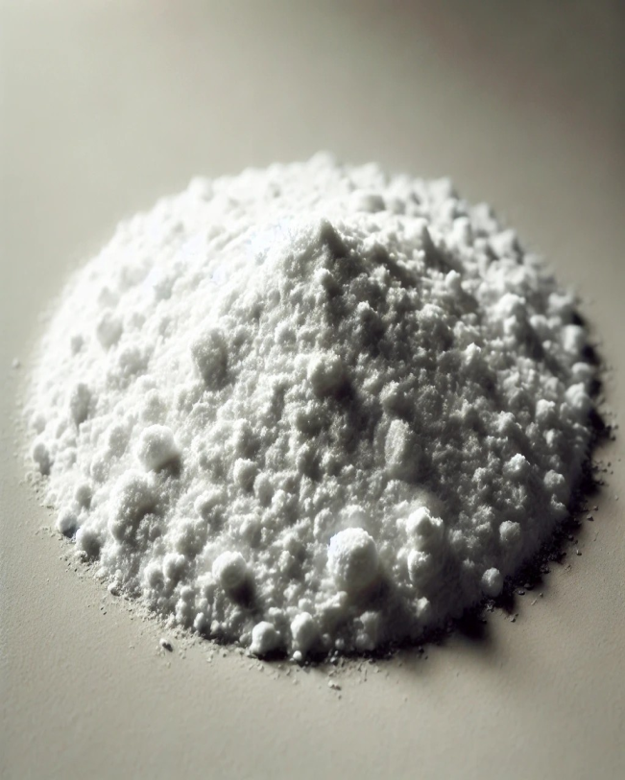
4. Sodium Tripoly Phosphate
odium Tripolyphosphate (STPP) is an inorganic compound with the chemical formula Na₅P₃O₁₀.
Usage:
Detergents & Cleaning Agents
Food Industry
Ceramic & Textile Industry
Water Treatment
Oil Drilling
Sodium Tripolyphosphate (STPP) appears as a white, crystalline powder or granular material.

Slide 19
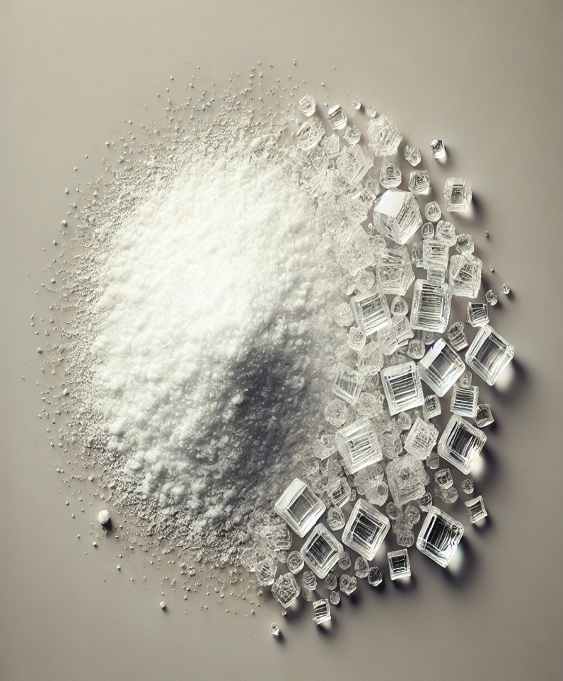
5. Sodium Carbonate
Sodium carbonate (Na₂CO₃), also known as soda ash or washing soda, is a white, water-soluble inorganic compound with alkaline properties. It is commonly used in industries such as glass manufacturing, detergent production, and water treatment.
Usage:
Glass Industry
Detergents & Soaps
Water Treatment
Food Industry
Textile Industry
Sodium carbonate appears as a white, odorless, crystalline powder or granular solid.

Slide 20
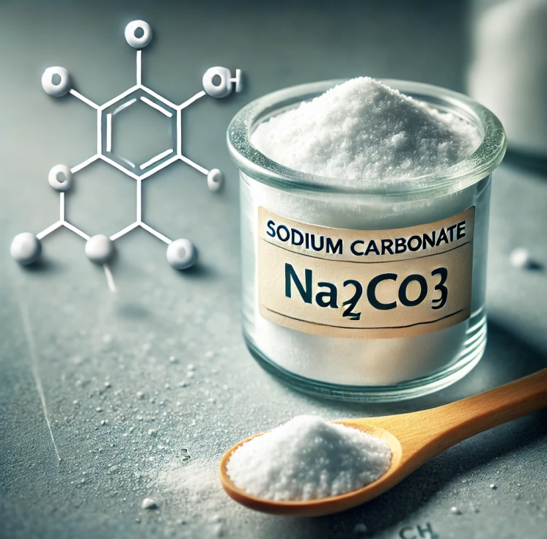
6. Sodium Carbonate
Sodium carbonate (Na₂CO₃), also known as soda ash or washing soda, is a white, water-soluble, alkaline compound. It has a variety of industrial, household, and chemical applications.
Uses of Sodium Carbonate:
Glass Manufacturing
Detergents & Cleaning Agents
pH Regulation
Textile Industry
Paper Industry
Chemical Synthesis
Appearance: White crystalline powder or granular

Slide 21
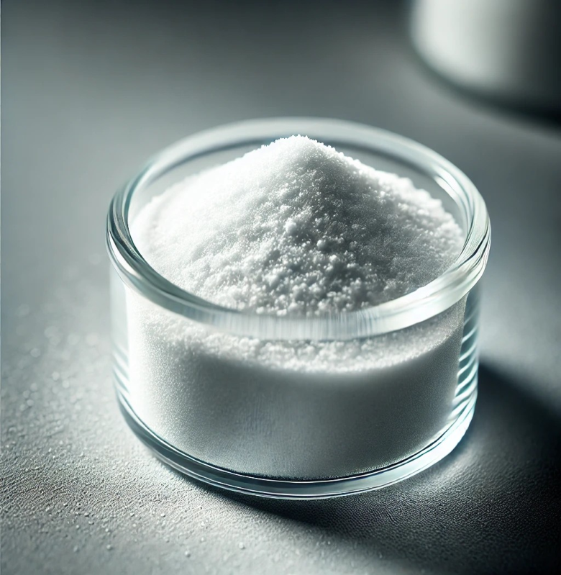
7. Sodium Hydrosulphite
Sodium Hydrosulphite (Na₂S₂O₄), also known as sodium dithionite, is a white crystalline powder primarily used as a reducing agent in various industries.
Uses:
Textile Industry
Paper & Pulp Industry
Food Industry
Water Treatment
Chemical Synthesis
Appearance: White to off-white crystalline powder

Slide 22
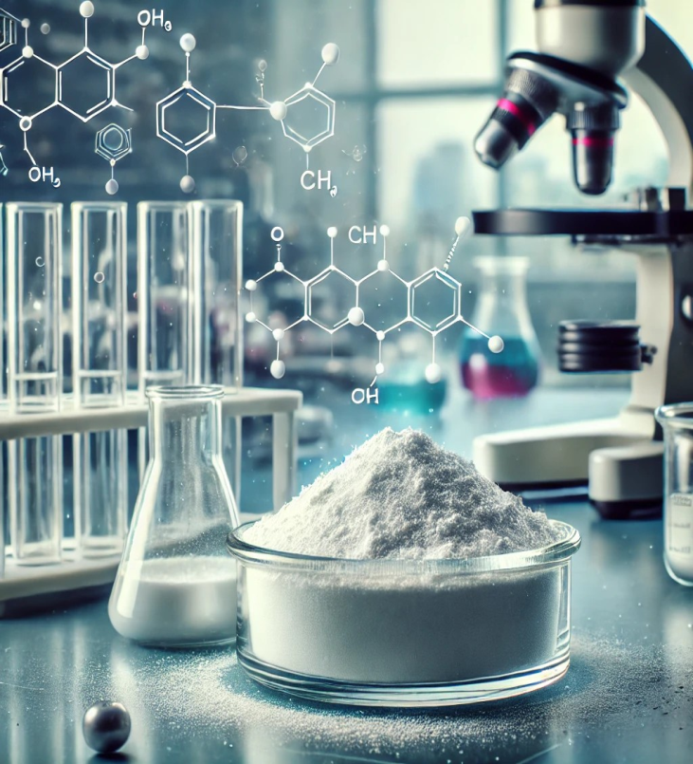
8. Titanium Dioxide
Titanium Dioxide (TiO₂) is a naturally occurring mineral widely used for its bright white color, opacity, and UV-resistant properties.
Uses
Color & Opacity
Sunscreen & Skincare
Food Additive (E171
Pharmaceuticals & Cosmetics
Industrial Applications
Titanium Dioxide (TiO₂) appears as a fine, white, odorless powder.

Slide 23
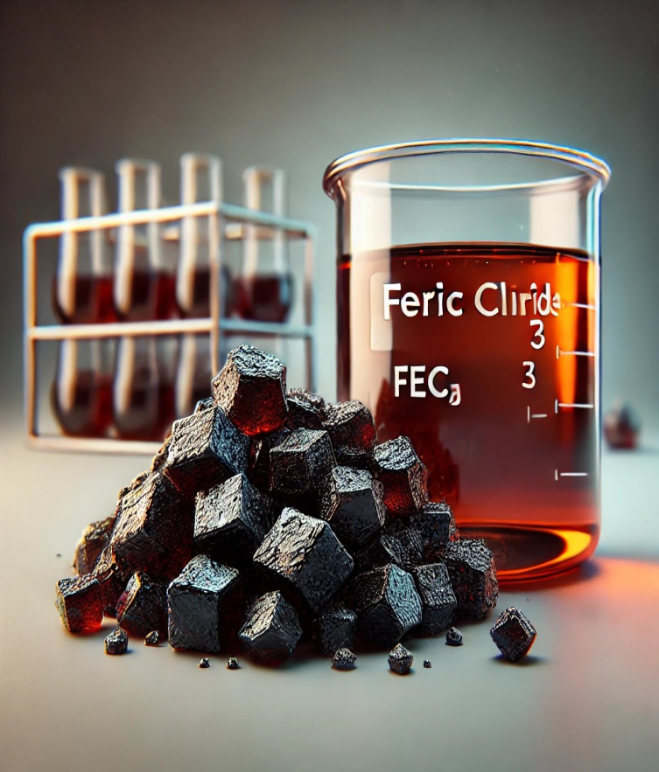
9. Ferric Chloride
Ferric chloride (FeCl₃) is a chemical compound commonly used in various industrial applications.
Uses
Water Treatment
Etching Agent
Medical Applications
Dyeing and Printing
Catalyst
Appearance: Dark brown or black crystalline solid

Slide 24
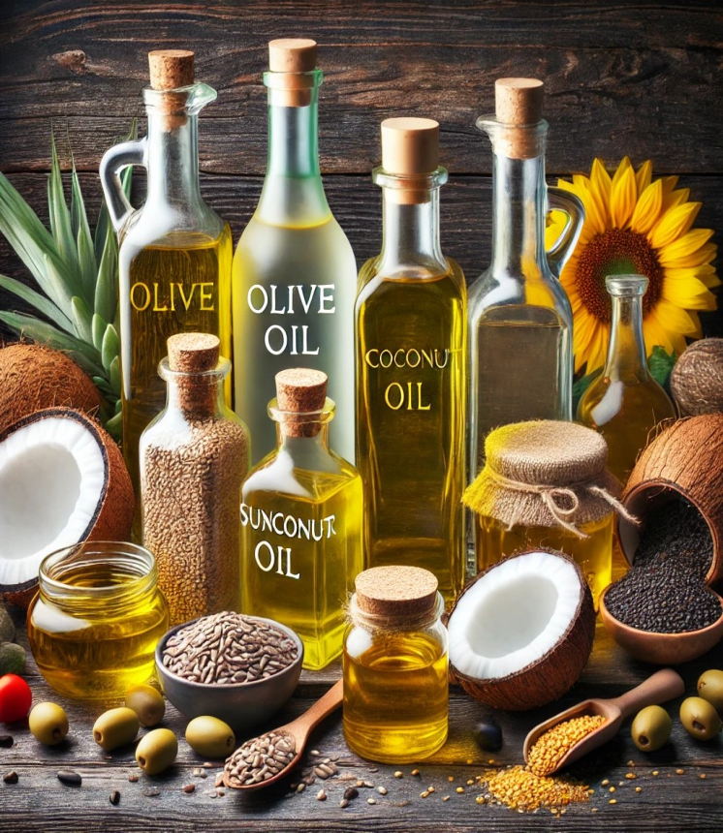
Oils
Roasted coconut oil
Virgin Coconut Oil
Mustard oil
Sesame oil
Rice bran oil
Vegetable Oil
Olive Oil (Extra Virgin, Virgin, Pure)
Sunflower
Mustard Oil
Soybean Oil
Palm Oil
Ghee / Clarified Butter

Slide 25



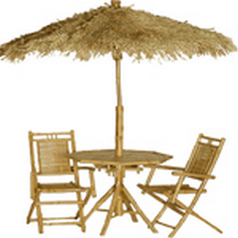
Jute
Jute is a natural fiber obtained from the bark of the jute plant, primarily Corchorus olitorius and Corchorus capsularis.
It is known as the "Golden Fiber" due to its golden, silky appearance and high commercial value.
Jute is biodegradable, eco-friendly, and one of the most affordable natural fiber.
Uses of Jute:
Textile Industry
Packaging
Home Décor
Agriculture
Paper Industry

Slide 26
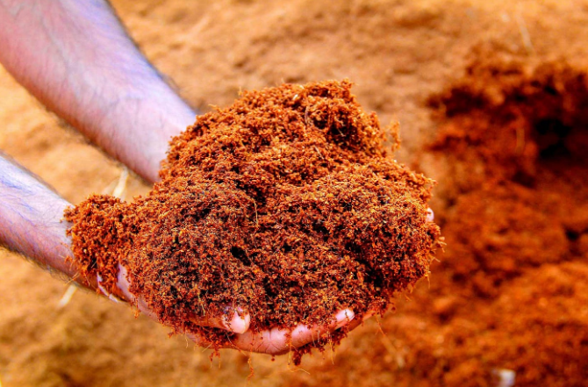
Coco Peat
Coco peat soil, also known as coir or coir dust, is a revolutionary planting medium that has gained widespread recognition for its eco-friendliness and outstanding horticultural benefits.
Extracted from coconut husks, coco peat is a renewable resource that has proven to be a game-changer in modern gardening and agricultural practices.
In this comprehensive guide, we explore the nature, uses, properties, and advantages of coco peat soil, as well as how to harness its potential for optimal plant growth.

Slide 27

Garments
Garments are textile-based products designed to be worn by individuals for protection, comfort, style, and cultural expression. They include a wide range of clothing items made from different fabrics, such as cotton, wool, silk, polyester, and synthetic blends.
Types of Graments:
Casual
Formal
Ethnic
Sportswear & Activewear
Workwear & Uniforms
Undergarments & Loungewear

Slide 28



Ramprasad GVSS.,
Founder & MD.,
📞 +91 7386112277,
✉️ Email: cmd@motherindgroup.com | ramprawsadindia@gmail.com
🌐 Website: www.motherindiagroup.com

